Slide 1
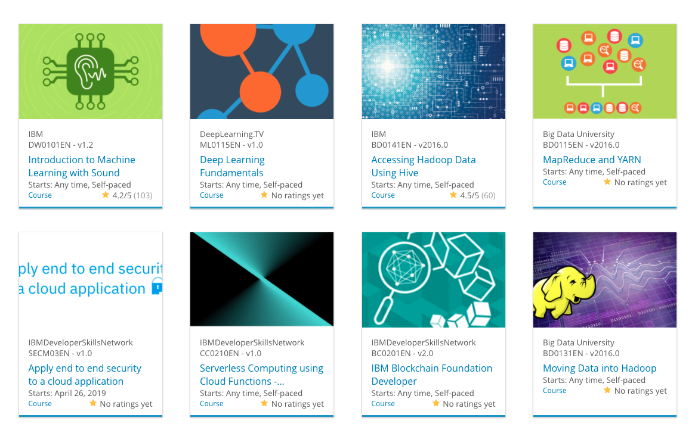

Build a Personalized Online Course Recommender System with Machine Learning
Mohamed MZAOUALI
August the 21th, 2022

Slide 2

Outline
Introduction and Background
Exploratory Data Analysis
Content-based Recommender System using Unsupervised Learning
Collaborative-filtering based Recommender System using Supervised learning
Conclusion
Appendix

Slide 3
Introduction
Data
User rating of Audited courses
User rating of Completed Courses
Tools
Supervised ML Models
Unsupervised ML Models
Goal
Generate Course Recommendations

Slide 4
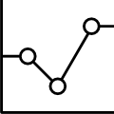
Exploratory Data Analysis

Slide 5
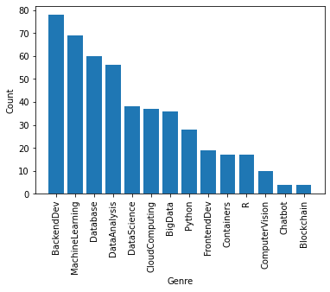
Course counts per genre
Using seaborn barplot method to plot course genre counts using a barchart.

Slide 6
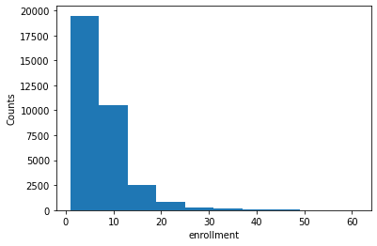
Course enrollment distribution
Using the Matplotlib hist methods to get a histogram showing the enrollment distributions

Slide 7
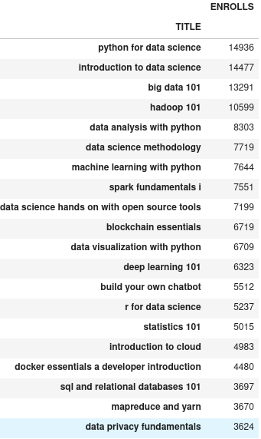
20 most popular courses
The 20 items with the most rating counts

Slide 8
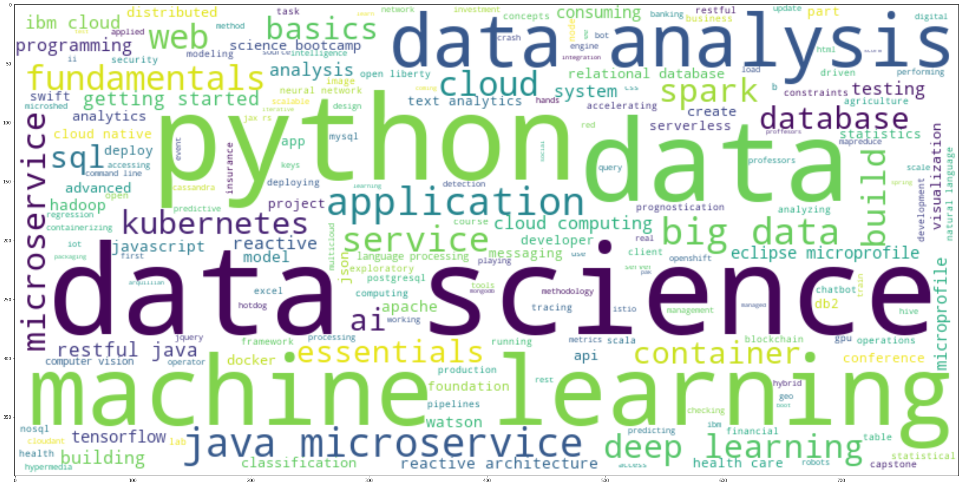
Word cloud of course titles
Popular IT keywords from the course titles

Slide 9
Content-based Recommender System using Unsupervised Learning
Cluster2
Cluster1

Slide 10
Flowchart of content-based recommender system using user profile and course genres
Raw Data
From Enrolled Courses Data
Extract User Profile Vector
Extract Course Genre Vector
Dot Product
Score
Select Courses
From Non Enrolled Courses Data
According to Threshold Check
Recommandations

Slide 11
Evaluation results of user profile-based recommender system
The top-10 commonly recommended courses across all users are:
TA0106EN
GPXX0IBEN
excourse22
excourse21
ML0122EN
GPXX0TY1EN
excourse04
excourse06
excourse31
excourse73
score_threshold = 10.0
On average, 61 new/unseen courses have been recommended per user (in the test user dataset)

Slide 12
Flowchart of content-based recommender system using course similarity
Raw DATA
Similarity Matrix
Split Courses
Similarity Threshold
Recommandation List
Enrolled
Unselected
Extract Similar Courses

Slide 13
Evaluation results of course similarity based recommender system
'BD0101EN'
'DS0101EN'
'DS0110EN'
'excourse04'
'excourse23'
'excourse32'
'excourse33'
'excourse36'
'excourse63'
'excourse67'
'excourse68'
'excourse72'
score_threshold = 0.6
On average, 12 new/unseen courses have been recommended per user (in the test user dataset)

Slide 14
Flowchart of clustering-based recommender system
Raw Data
Data user profile dataset
Transform data
Normalization/Standardization
Dimensionality reduction
Modeling
Generate user's clusters
Predict clusters
User's testset
Recommand
Unenrolled courses
Treshold controle
Limit recommendations to the desired confidence level.
Top Recommandation list

Slide 15
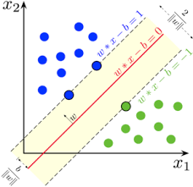
Collaborative-filtering Recommender System using Supervised Learning

Slide 16
Flowchart of KNN based recommender system
Raw Data
User-Item interaction matrix
Transform Raw Data
Sparse Matrix
Modeling
Scikit Surprise Package
K Nearest Neighbors
Predict
User's similarities
Evaluate RMSE
Recommendations list's
Based on users's similiraties or neighborhoods

Slide 17
Flowchart of NMF based recommender system
Raw Data
User-Item interaction matrix
Transform Raw Data
Sparse Matrix
Modeling
Scikit Surprise Package
Non Negative Matrix Factorization
Predict
User's similarities
Evaluate RMSE
Recommendations list's
Based on users' similarities or neighborhoods

Slide 18
Flowchart of Neural Network Embedding based recommender system
Raw Data
Rating Dataset
Transform Data
One Hot Encoding users and items
Spliting Dataset into training and test sets
Modeling
Extracting latent features using Neural Nets
Extracting Recommendations using trained Neural Nets
Predicting
Model Assessment
RMSE metric

Slide 19
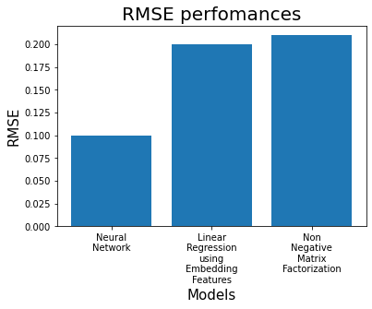
Compare the performance of collaborative-filtering models

Slide 20
Conclusions
Recommender Systems
Based
Sparse Matrix
Limitations
Out Of Memory
Curse of Dimensionality
Alternative Solutions
Deep Neural Network
Static Recommendation Systems
Deep Reinforcement Learning
Dynamic and Online Recommendation Systems

Slide 21
Appendix
The entire project capstone can be fount in the followin Github repo:
https://github.com/mzaoualim/Coursera_IBM_Machine_Learning_Professional_Certificate/tree/main/Machine%20Learning%20Capstone

